Slide 1
Clusters and GRIDs
High Throughput Computing
Making the most from what you have

Slide 2



Computing Cluster
Definition: A computer cluster is a set of loosely or tightly connected computers that work together so that, in many respects, they can be viewed as a single system
Basic components of computing cluster
Usually:
Fast local network
All computers are similar or same hardware
All computers run same operating system (Version and distribution)
Distributed file system
No monitors
Private network
Outbound Internet access
No inbound Internet access
Hardware generally chosen by highest performance to cost ratio
Jobs managed and queued by batch system (Condor, PBS, SLURM)
Middleware software to manage computer configuration (Puppet)
Middleware software to install operating systems (Cobbler)
Important concepts: Configuration management and provisioning

Slide 3
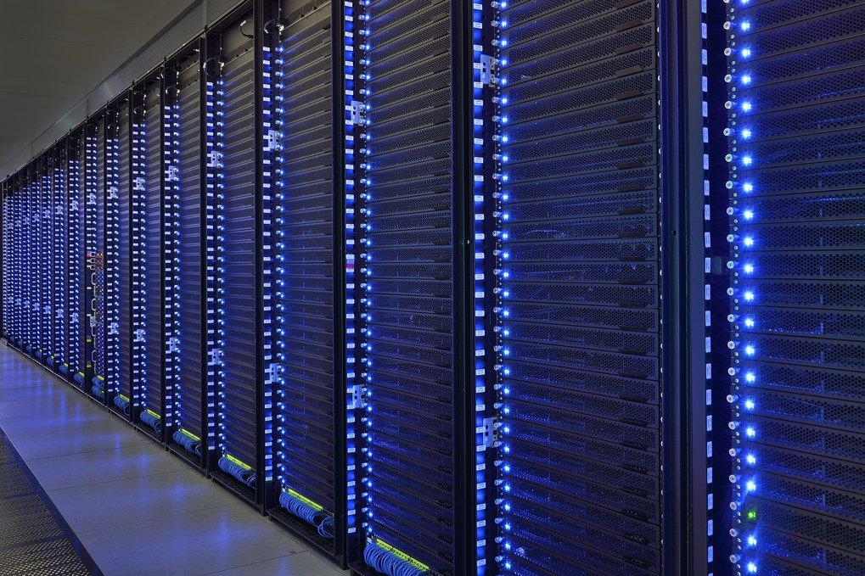
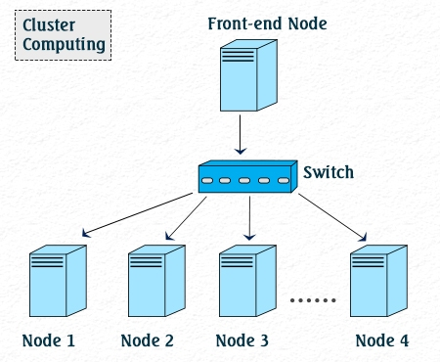
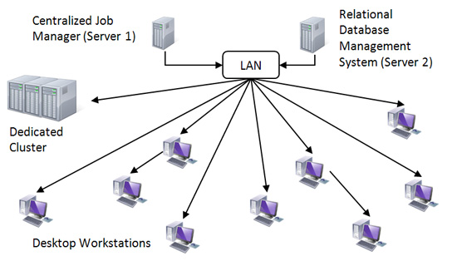
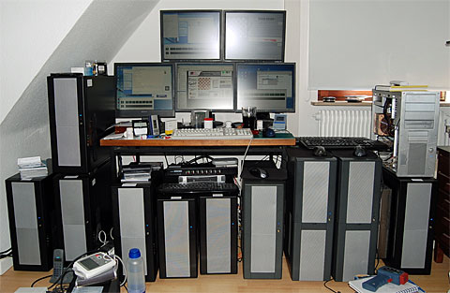
Computing Clusters

Slide 4
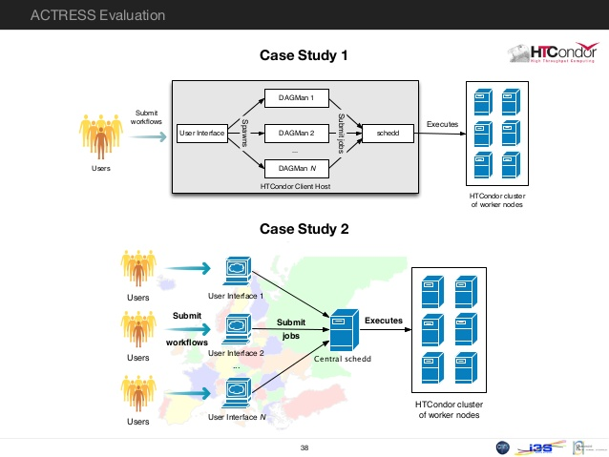
HTCondor is an open-source high-throughput computing software framework for coarse-grained distributed parallelization of computationally intensive tasks.^{[1]} It can be used to manage workload on a dedicated cluster of computers, or to farm out work to idle desktop computers – so-called cycle scavenging. HTCondor runs on Linux, Unix, Mac OS X, FreeBSD, and Microsoft Windows operating systems.
DAGMan (Directed Acyclic Graph Manager) is a meta-scheduler for HTCondor. It manages dependencies between jobs at a higher level than the HTCondor Scheduler.

Slide 5
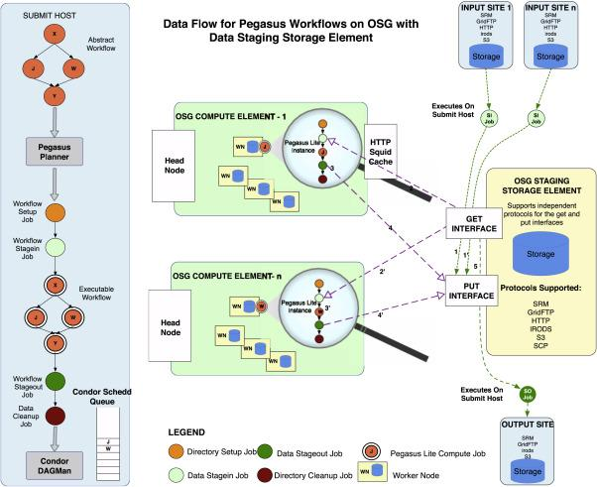

The Pegasus Workflow Management System, maps abstract workflow descriptions onto distributed computing infrastructures. Pegasus has been used for more than twelve years by scientists in a wide variety of domains, including astronomy, seismology, bioinformatics, physics and others.
Pegasus
Pegasus Work Flow

Slide 6
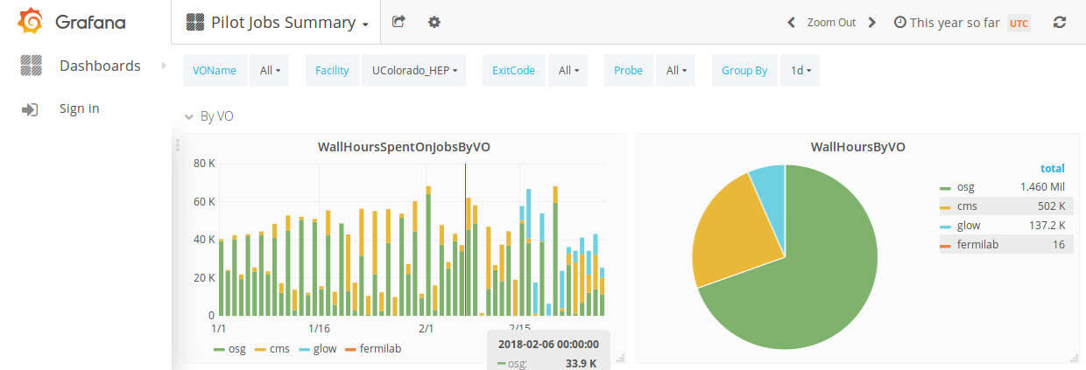
High Energy Physics Cluster at University of Colorado
About 200 compute nodes
About 1700 cores (batch slots)
1.4 PB of Hadoop data storage
500 TB of NFS data storage
About 20 support servers
10 Gb Internet connection
Mix of 10Gb and 1Gb in computer room
In 2017, the cluster ran for about 10 Million CPU hours
2018 (Jan 1 - today) - 3.9 Million CPU hours

Slide 7
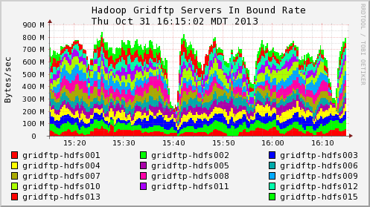
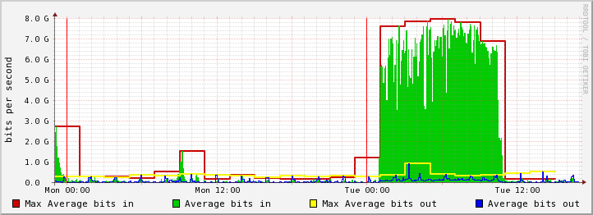
Network Performance at the University of Colorado
Internally transferring data at about 700 MB/s
Externally transferring data at about 7Gb/s

Slide 8
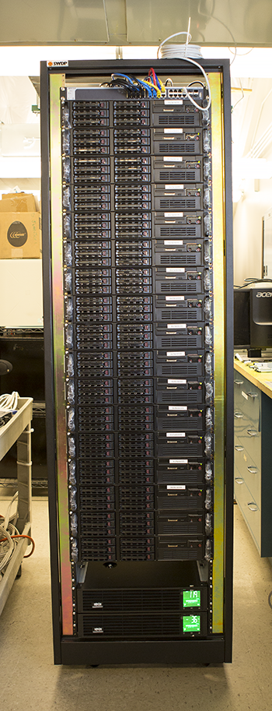
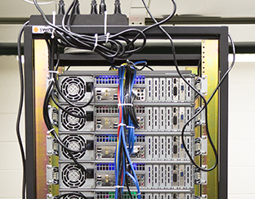
New Rack assembled December 2017
15 nodes
64 GB RAM/node
240 cores
180 TB Hadoop disk space
Approximately 4000 HEPSPEC06
Built completely in house from off the shelf components
Cost ~$40K

Slide 9

Accomplishments to date by An Najah HTC Class
Installed an initial operating system from USB
Called the initial machine our server
Configured the server to be a Cobbler Server
Used PXEBOOT to net-install the second machine referred to as client
Configured the server to be a Puppet Server
Used Puppet Server to configure client machine
Installed autofs from command line on the server
Used Puppet to install autofs on the client
With autofs installed you can now NFS mount /nfs/htc180
Added an addition disk to the class server /nfs/htc-data
Added to autofs on both the server and the client
Installed HTCondor from the command line on the server
Installed HTCondor using Puppet on the client
Ran our first cluster computing job - Calculation of π using Monte Carlo Methods
Ran first jobs using the XSEDE facility is the United States

Slide 10

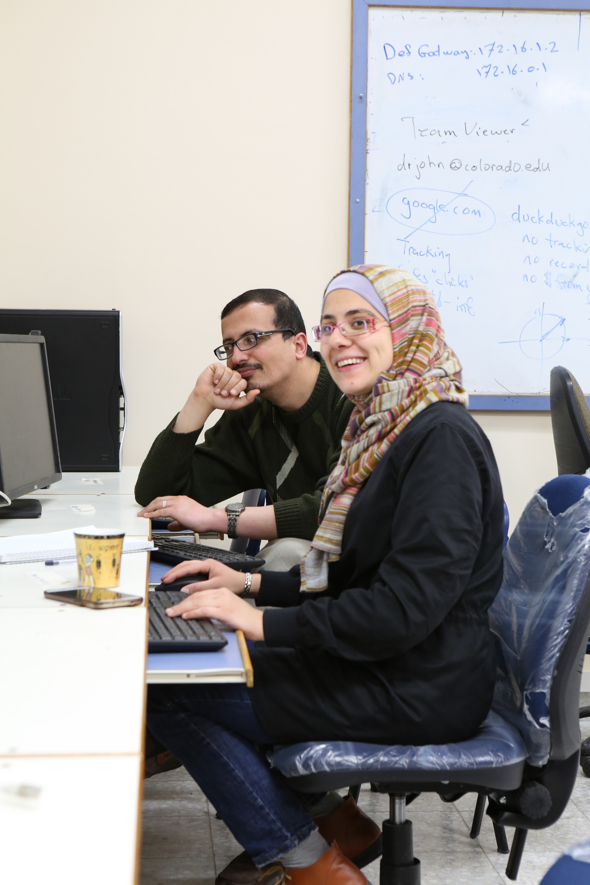
An Najah HTC Class
Spring 2018

Slide 11
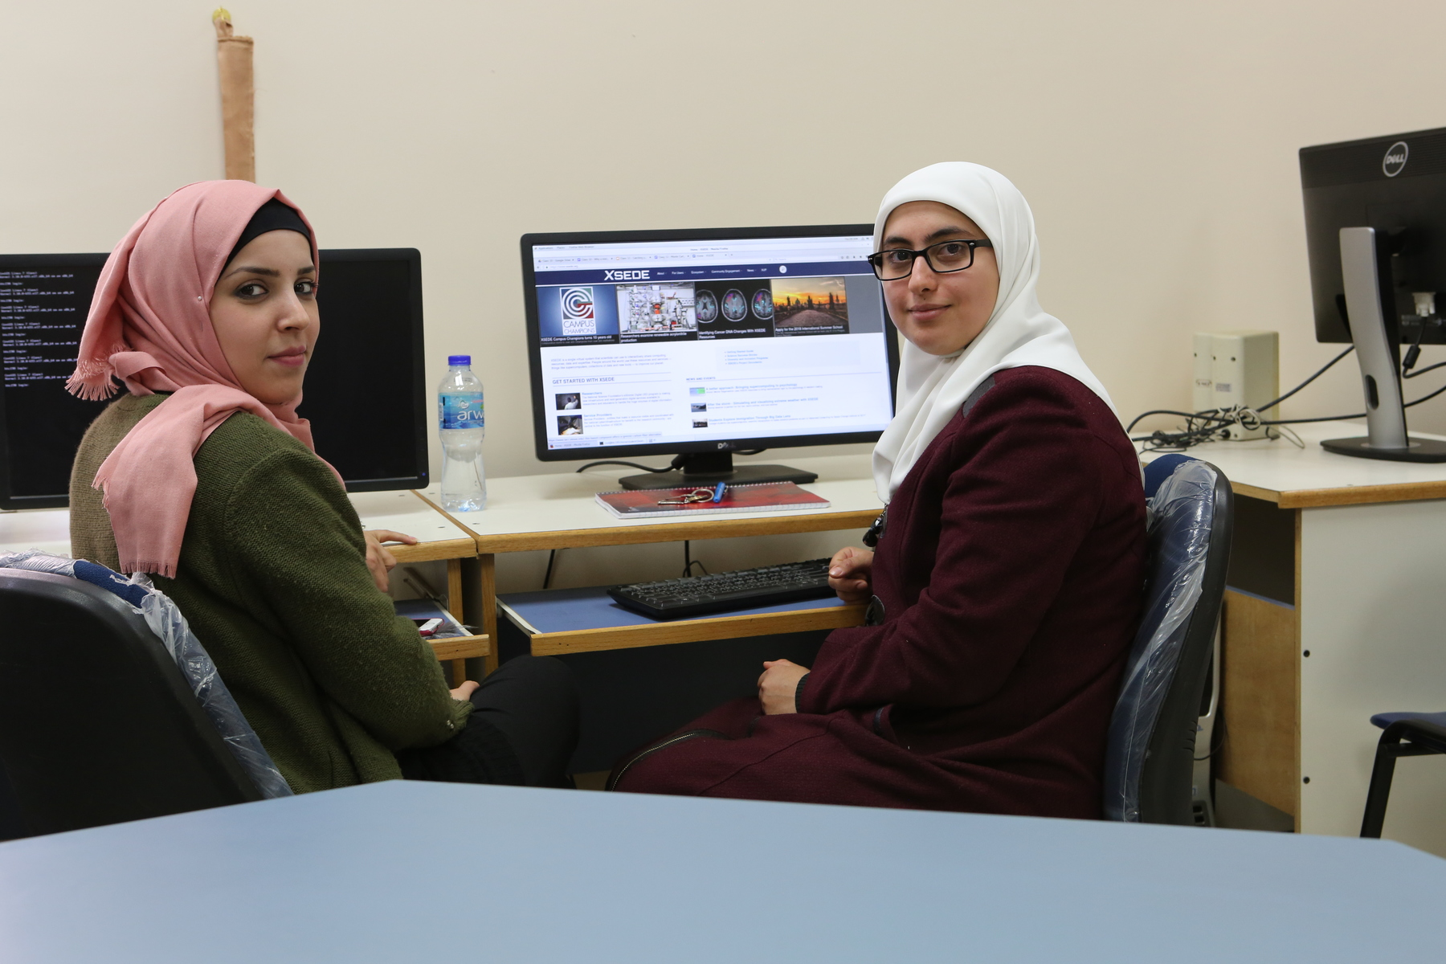

An Najah HTC Class
Spring 2018

Slide 12
Transitioning to One Room, One World, One Cluster
It is now time to transition from having 5 separate mini clusters in the room to having one cluster with 11 compute nodes.
This cluster with have a total of 44 cores.; up to 66 if we run on the server.
Some Future Features:
Distributed high performance file system (Hadoop)
NFS file system for long term storage.
NFS file system will be on the class server.
Hadoop file system will be distributed across all the machines.
Central managed accounts that are available on all machines

Slide 13
New Google Drive Subdirectory: Transition to single cluster
Transition Documentation:
00 Task List for Creating Cluster Room
Documents that are a work in progress:
Cluster Account Creation and Management
Ganglia - Network Utilization Monitoring
Nagios System Monitoring
Puppet - node.py, profile and role
Puppet Forge - Community Modules
Python tutorial
Setting up class server
Singularity Containers
Virtual Machines and Containers
Working with hiera data
Working with Puppet Templates
Documents are in different states of development.
More to come

Slide 14
In case you think that it always takes big systems to accomplish a lot, at the University of Colorado, the High Energy Theory group has access to some of the largest supercomputers in the world.
They also have a small cluster of about 50 Core i7s.
Between about 2014 and 2017 they published over 25 refereed papers from research done solely by using this small cluster.
They found a problem that they were able to thoroughly explore based on their available resources.

